Slide 1
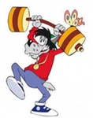
Физкультминутки на английском

Slide 2
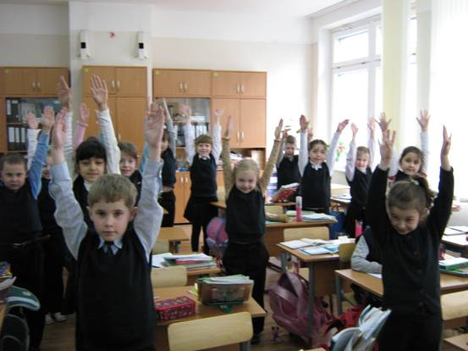

Slide 3
I can
I can hop like a rabbit. (прыгаем как кролик)
I can jump like a frog. (прыгаем как лягушка) I can fly like a bird. (летаем как птичка) I can run like a foх. (бегаем как лисичка) I can walk like a duck. (ходим как уточка) I can swim like a fish. (плаваем как рыбка) And be still as good children - (и становимся хорошими детками) as still as this. (вот так)

Slide 4
Teddy Bear, Teddy Bear
Teddy Bear, Teddy Bear, touch your nose
Teddy Bear, Teddy Bear, touch your toes;
Teddy Bear, Teddy Bear, touch the ground,
Teddy Bear, Teddy Bear, turn around.
Teddy Bear, Teddy Bear, turn around,
Teddy Bear, Teddy Bear, touch the ground,
Teddy Bear, Teddy Bear, reach up high
Teddy Bear, Teddy Bear, wink one eye,
Teddy Bear, Teddy Bear, slap your knees,
Teddy Bear, Teddy Bear, sit down please

Slide 5
Hands!
Hands up!
Hands down!
Hands on hips!
Sit down!
Hands up!
To the sides!
Bend left!
Bend right!
One, two, three! Hop!
One, two, three! Stop!
Stand still!

Slide 6
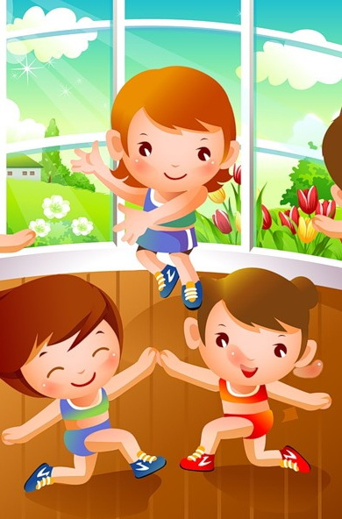
Come, my friend
Come, my friend and dance with me It is easy, you can see. One step back, one step out. Then you turn yourself around It is fun to dance with you, And it isn't hard to do. One step back, one step out, Then you turn yourself around

Slide 7
Hands on the head,(руки на голову) Hands on the hips,(руки на пояс) Hands on the table,(руки на стол) Hands like this.(Любое движение.) Hands on the shoulders,(на плечи) Hands up and down,(руки наверх, вниз) Hands behind the head And sit down!(садятся)

Slide 8
Hands up! Clap! Clap! Clap!
Hands down! Shake! Shake! Shake!
Hands on hips! Jump! Jump! Jump!
Hop! Hop! Hop! Stop! Stand still!
Good! Sit down, please!

Slide 9
One, One, one,
Little dog, run!
Two, two, two,
Cats see you.
Three, three, three.
Birds in the tree.
Four, four, four.
Frogs on the floor

Slide 10
Working about the house!
One, two – tie your shoe!
Three, four – mop the floor!
Five, six – pick up bricks!
Seven, eight – wash a plate!
Nine, ten – begin again!
(That’s the end!)

Slide 11
Parts of the body!
Head and shoulders,
knees and toes, knees and toes, knees and toes!
Head and shoulders,
knees and toes,
eyes, ears, mouth and nose!

